Slide 1
SIT113 Cloud Computing and Virtualisation
Week 8, Class 1
Cloud Architectures

Slide 2
Outline
Fundamental Cloud Architectures (Chapter 11)
Workload Distribution Architecture
Resource Pooling Architecture (sibling/nested)
Dynamic Scalability Architecture (HVR)
Elastic Resource Capacity Architecture (scripts)
Service Load Balancing Architecture (indep/in-built)
Cloud Bursting Architecture (on-premise to cloud)
Elastic Disk Provisioning Architecture (thick/thin)
Redundant Storage Architecture

Slide 3
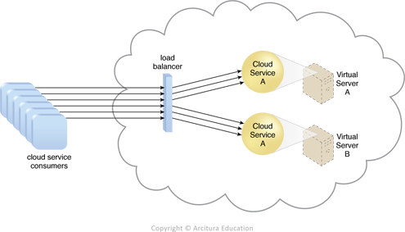
Workload Distribution Architecture
horizontal scaling and a load balancer evenly distribute workload among IT resources

Slide 4
Workload Distribution Architecture
Additional Mechanisms
Audit Monitor: type and geographical location of IT resources may require monitoring for legal and regulatory requirements
Cloud Usage Monitor: used for runtime workload tracking and data processing
Hypervisor: distribution of workload between hypervisors and hosted virtual servers

Slide 5
Workload Distribution Architecture
Logical Network Perimeter: isolates cloud consumer network boundaries where workloads are distributed
Resource Cluster: active-active (rather than active/passive) cluster groups are commonly used to help balance workloads across cluster members
Resource Replication: can generate new instances in response to runtime demands

Slide 6
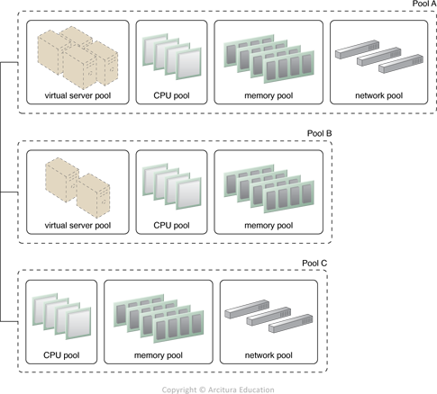
Resource Pooling Architecture
uses one or more resource pools where identical IT resources are synchronised
Sibling Pools (physically grouped, and isolated from one another)

Slide 7
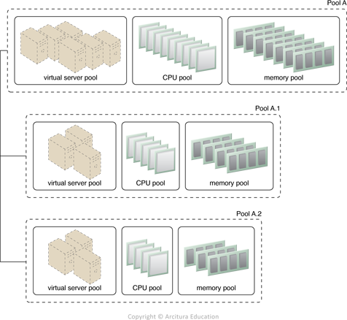
Resource Pooling Architecture
Nested Pools (same type of IT resources, each department of an organisation can be assigned a pool)

Slide 8
Resource Pooling Architecture
Additional Mechanisms
Audit Monitor
Cloud Usage Monitor
Hypervisor
Logical Network Perimeter
Resource Replication
Pay-Per-Use Monitor: collects usage and billing information

Slide 9
Resource Pooling Architecture
Remote Administration System: interfaces with backend systems to provide functionality to administer pools
Resource Management System: allows cloud consumers to manage pools

Slide 10
Dynamic Scalability Architecture
dynamic allocation of IT resources from resource pools based on predefined scaling conditions
Dynamic horizontal scaling
Dynamic vertical scaling, and
Dynamic relocation

Slide 11
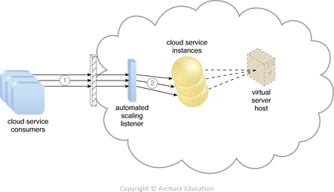
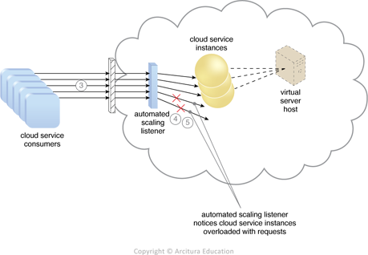
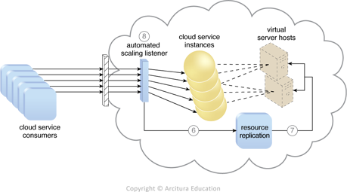
Dynamic Scalability Architecture
1 2
3

Slide 12
Dynamic Scalability Architecture
Additional Mechanisms
Cloud Usage Monitor
Hypervisor
Pay-Per-Use Monitor

Slide 13
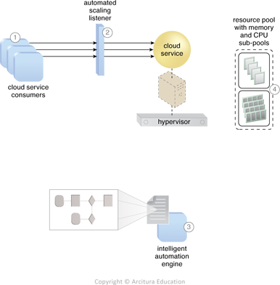
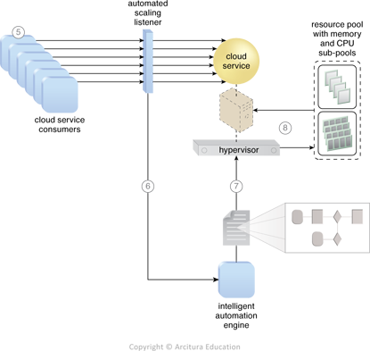
Elastic Resource Capacity Architecture
allocates and reclaims CPUs and RAM in immediate response to fluctuating requirements

Slide 14
Elastic Resource Capacity Architecture
Additional Mechanisms
Cloud Usage Monitor
Pay-Per-Use Monitor
Resource Replication

Slide 15
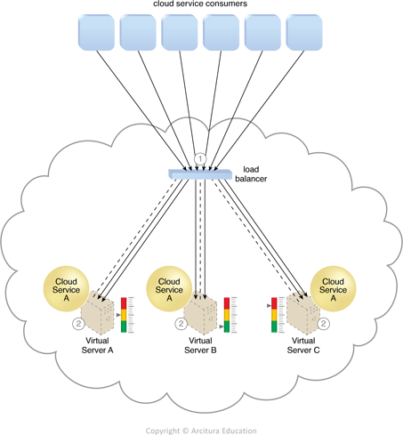
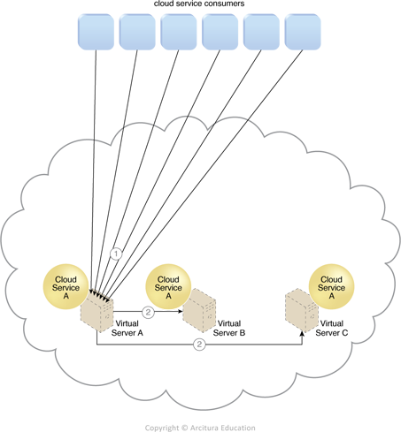
Service Load Balancing Architecture
variation of workload distribution architecture
load balancing is independent or built-in

Slide 16
Service Load Balancing Architecture
Additional Mechanisms
Cloud Usage Monitor
Resource Cluster
Resource Replication

Slide 17
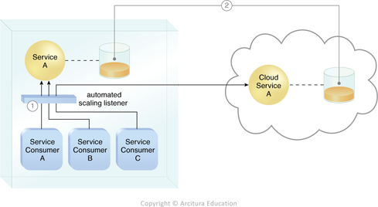
Cloud Bursting Architecture
dynamic scaling - on-premise IT resources are used but “bursts out” to cloud-based IT resources during high-demand periods

Slide 18
Cloud Bursting Architecture
Additional Mechanisms
Resource Replication

Slide 19
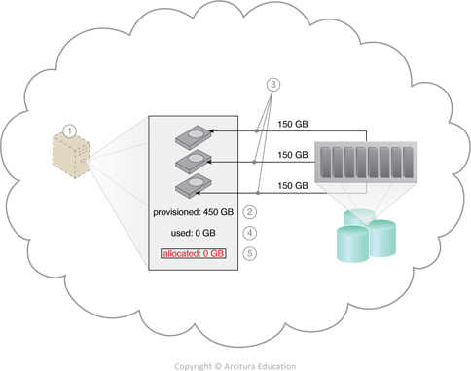
Elastic Disk Provisioning Architecture
thin provisioning of storage for charging based on actual data usage (not maximum capacity)
Thin – storage is provisioned but not necessarily allocated from physical resources

Slide 20
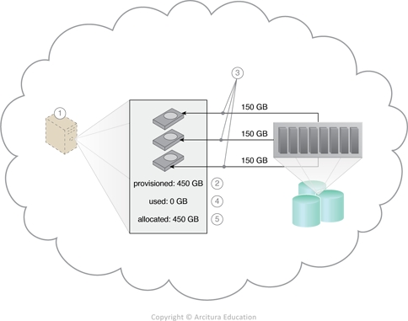
Elastic Disk Provisioning Architecture
Thick – physical storage is allocated/reserved to match provisioned

Slide 21
Elastic Disk Provisioning Architecture
Additional Mechanisms
Cloud Usage Monitor
Resource Replication

Slide 22
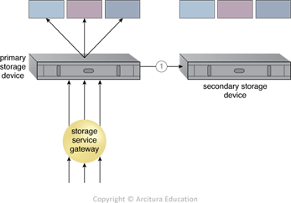
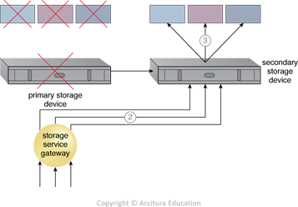
Redundant Storage Architecture
failover system uses duplicate/replicated cloud storage device

Slide 23
Redundant Storage Architecture
Additional Mechanisms
Storage replication: synchronously/asynchronously replicates data from primary to secondary device
Storage service gateway: diverts cloud consumer requests to the secondary device whenever the primary device fails
Location: the duplicate might be stored at another geographical region (subject to legal/regulatory requirements)

Slide 24
Summary
Fundamental Cloud Architectures (Chapter 11)
Workload Distribution Architecture
Resource Pooling Architecture (sibling/nested)
Dynamic Scalability Architecture (HVR)
Elastic Resource Capacity Architecture (scripts)
Service Load Balancing Architecture (indep/in-built)
Cloud Bursting Architecture (on-premise to cloud)
Elastic Disk Provisioning Architecture (thick/thin)
Redundant Storage Architecture

